Slide 1

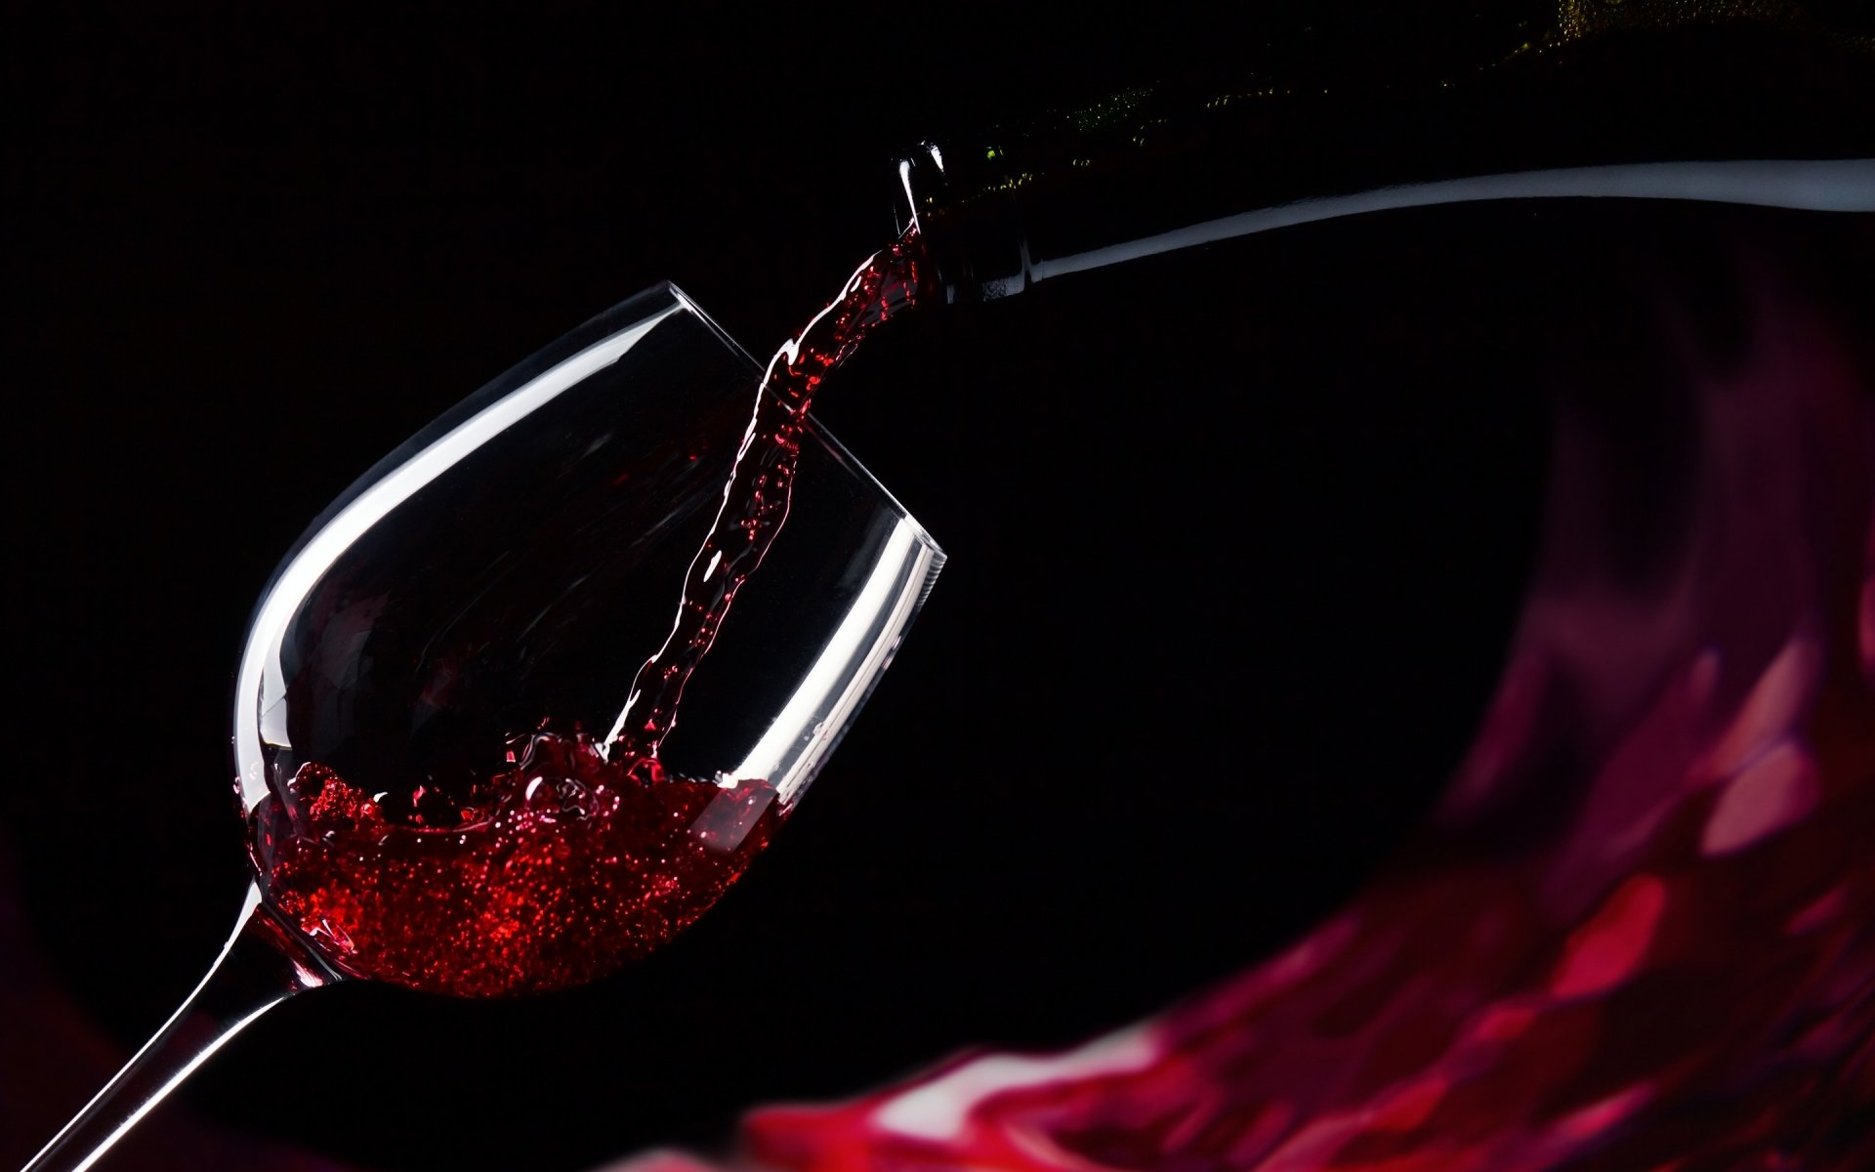
Red Wine Quality Predictors by The Three Musketeers

Slide 2

Autumn Heyman
Education: BS Alternative Medicine (Everglades University)
MPH Complementary & Alternative Medicine, Functional Nutrition (Everglades University)
MBA Non-Profit Leadership & Management (Liberty University)
Current Profession: Sole-proprietor facilitating respite, in-home, and community service supports for adults with developmental/intellectual disabilities
Data Science Pursuits: Field research, analyzation, and program development to address turnover, retention, and employment attraction to the field.
Tools to convert field documentation into actionable agency policies to provide more customed, tailored delivery of individual supports.
Public policy development and reform.
Favorite Languages: R and Python
Favorite Wine: Malbec

Slide 3
Autumn Heyman
Education: BS Alternative Medicine (Everglades University)
MPH Complementary & Alternative Medicine, Functional Nutrition (Everglades University)
MBA Non-Profit Leadership & Management (Liberty University) (currently pursuing)
Current Profession: Sole-proprietor facilitating respite, in-home, and community service supports for adults with developmental/intellectual disabilities
Data Science Pursuits: Field research, analyzation, and program development to address turnover, retention, and employment attraction to the field.
Tools to convert field documentation into actionable agency policies to provide more customed, tailored delivery of individual supports.
Public policy development and reform.
Favorite Languages: R and Python
Favorite Wine: Malbec

Slide 4
Erin WeaveR
Introducing the Pantone Color of the Year 2022. PANTONE 17-3938 Very Peri is a dynamic hue that blends the faithfulness and constancy of blue with the energy and excitement of red.
The four color palettes in this template feature Very Peri to help you express your ideas and convey the right mood. Read on to learn how to use these colors in any presentation.

Slide 5
Georgia Miller
Army National Guard veteran with a background in Python and GIS
Favorite Language: R
Favorite wine: Merlot

Slide 6
Project Introduction & Background
You should have a couple slides of background information about the topic you are covering. For instance, if you are asking and answering questions about the stock market, you should give a little basic information about the stock market.
Try to build this up, so start with the most general information and then get more specific with information that directly relates to your data or the questions you will be answering with the data.

Slide 7
Wine Quality
Subjective
Objective

Slide 8
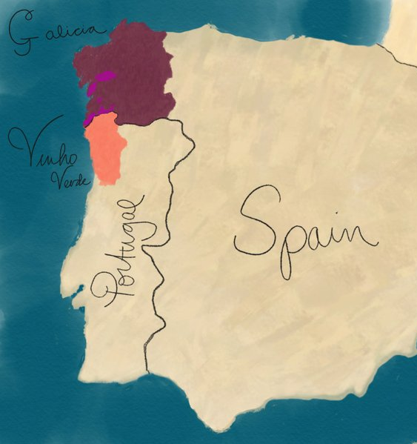
Wine region
Vinho Verde
Alvarinho & Loueiro
Amaral, Borraçal
Galicia
Albariño
Mencía
Notes: For this data, the original data set specifies that the wine samples came from the Minho area in the Vinho Verde region.
One of the references said something about the 14 different wine regions in Portugal. I don’t like the picture in the following link, but it does name out the 14 regions: https://www.paladarytomar.com/portugal-wine-regions/ I only make the point because the current info above doesn’t match the background info we have.

Slide 9
The DataSet
Study conducted by: Paulo Cortez, University of Minho, Guimarães, Portugal, http://www3.dsi.uminho.pt/pcortez , A. Cerdeira, F. Almeida, T. Matos and J. Reis, Viticulture Commission of the Vinho Verde Region(CVRVV), Porto, Portugal @2009
Quality score was determined by:
Scale: 3-4(poor), 5-6(average), 7-8(good)
Distribution: The original dataset is located on the UCI Machine Learning Repository: https://archive.ics.uci.edu/ml/datasets/wine+quality

Slide 10
Questions
Which physiochemical properties of wine have the greatest impact on wine quality?
What ratio of the properties selected cause the quality to differentiate from poor/average/good?

Slide 11
METHODS
Wrangle data / Recode quality
Tried stepwise binary logistic regression, results messy
Ordinal Logistic Regression / Confusion matrix
Second half:
Tried KMeans with original analysis
Went with LDA with other first analysis

Slide 12
METHODS
You also want to paint a picture of what your data is like. Include details such as:
Density, Chlorides, Volatile Acidity, & pH top variables
1599 cases, which will further reduce to 1143 cases once the data is cleaned and wrangled
The methods section should only be a few slides, and should not include any code. You are presenting to a wide, non-data science audience, and thus should not go into a lot of detail.

Slide 13
Results
The results section will be the meat of your presentation. You should divide your results section into parts by evaluation question, so that you can easily signpost things. In the results section, you will go over any of the exploratory findings you have you want discuss, as well as the answers to each evaluation question. Ensure that you provide LOTS of beautiful visuals to go along with your findings.

Slide 14
Summary
The summary should be JUST ONE SLIDE, and it should contain a summary of the entirety of your results section. It should be in layman's terms, quick and dirty.

Slide 15
Conclusions
Your conclusion section should also only be one slide long. In it, you should have some bullet points containing information about:
How do your findings impact the world at large?
What's important about this work?
Big picture information

Slide 16
Questions
Your presentation should conclude with a questions slide. All it needs to say is "Questions?" and it helps signify the end of the presentation and the beginning of the question and answer section of your big day. You should be prepared for questions like these:
If you had more time, what else would you do on this project?
What's next for you?
What was the most difficult part of this project?

Slide 18
Notes: I added a second version (‘Design Ideas’) of the personal Three Musketeers slide to pop it a bit.
Some of the other presentations I’ve seen have had some dynamic pictures as backgrounds that make the info and graphs pop, along with using the ‘Design Ideas’ in PowerPoint.
https://vimeo.com/showcase/8740303
Do we want to use any photos from the Minho region as background for some of the slides or tone some background pics into the wine color we currently have as the background so that when they see the data/graphs the wine tone is prominent? I really like that wine tone in the background and don’t want to lose that.
I’m more focused today on the content first and getting organized, just looking ahead to the final presentation edit “and joojing it up” a bit.

